Slide 1
Mechanical Layers of the Earth

Slide 2

By the end of this lesson, you should be able to:
Describe features of the lithosphere, asthenosphere and mesosphere.
Compare and contrast the physical properties of Earth's lithosphere, asthenosphere and mesosphere layers.

Slide 3
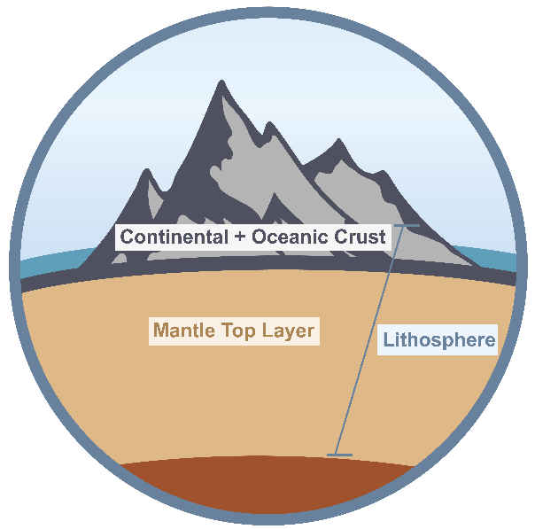
So what is the lithosphere?
The lithosphere is the solid, outer part of the Earth! It comprises the Earth's crust and the brittle upper portion of the mantle.
The lithosphere’s name comes from the Greek 'lithos + sphere', which means 'stone sphere'.
There are two types of lithosphere: oceanic lithosphere and continental lithosphere. Oceanic lithosphere is associated with oceanic crust, and is slightly denser than continental lithosphere.

Slide 4
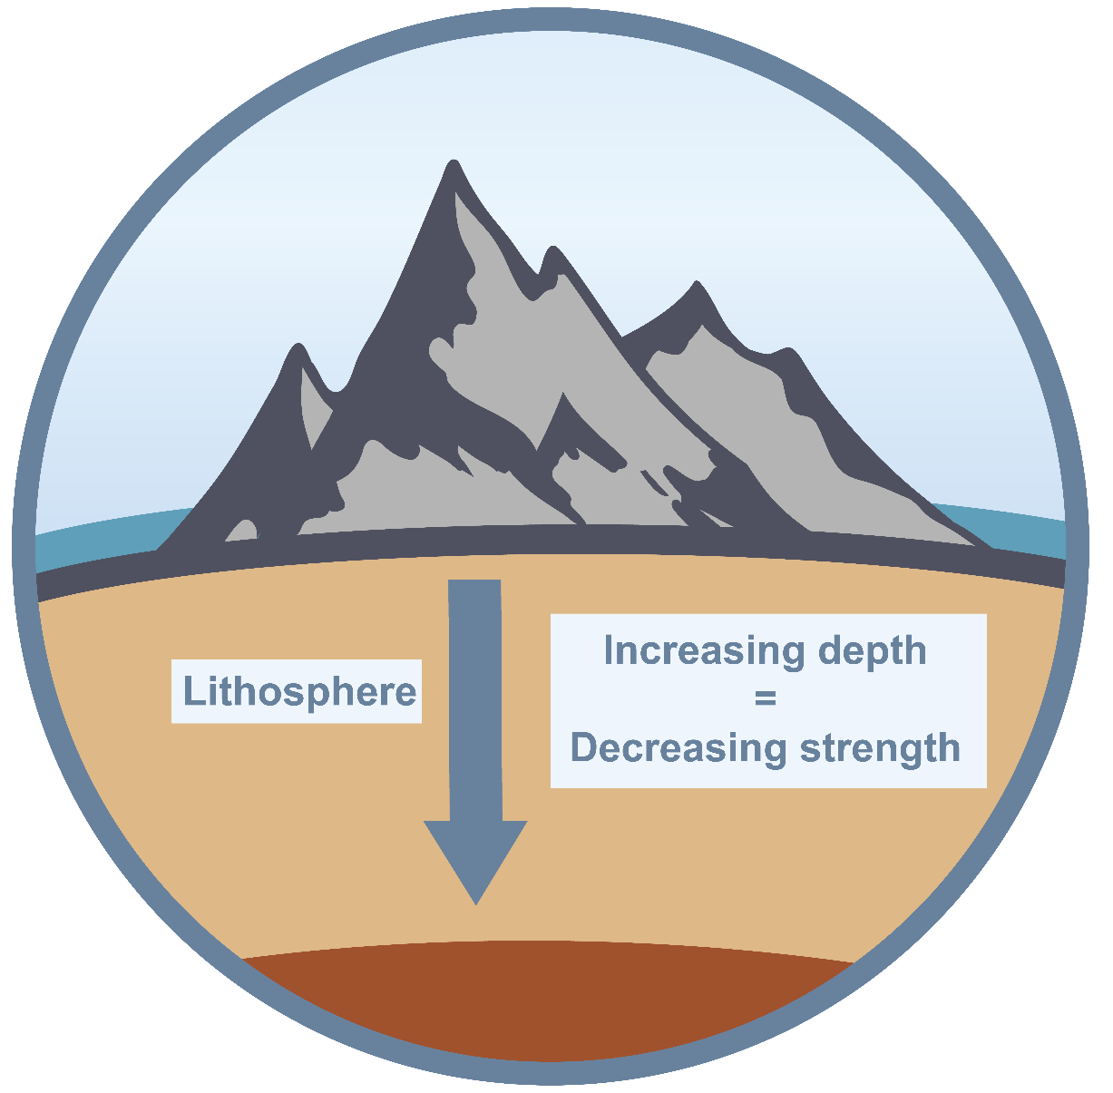
The lithosphere is composed of tough, rigid rocks.
This is because the lithosphere is relatively cool, which contributes to rock strength in this mechanical layer.
The deeper you go in the lithosphere (greater than 100 km), the hotter it gets.
This increase in temperature weakens the rock strength and leads to greater plasticity. The lithosphere can withstand a great amount of force before undergoing deformation.

Slide 5
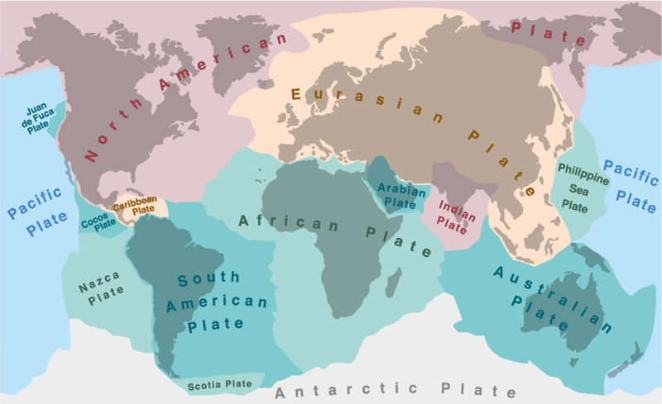
Despite its strength, the lithosphere did break up at some point in the distant past.
Instead of being a smooth sphere, the lithosphere is divided into massive plates of rock (tectonic plates). Together, these plates form a kind of shell that covers the softer asthenosphere underneath. They are the armour of our planet!
The most well-known feature associated with Earth’s lithosphere is tectonic activity. Tectonic activity describes the interactions between different tectonic plates.

Slide 6
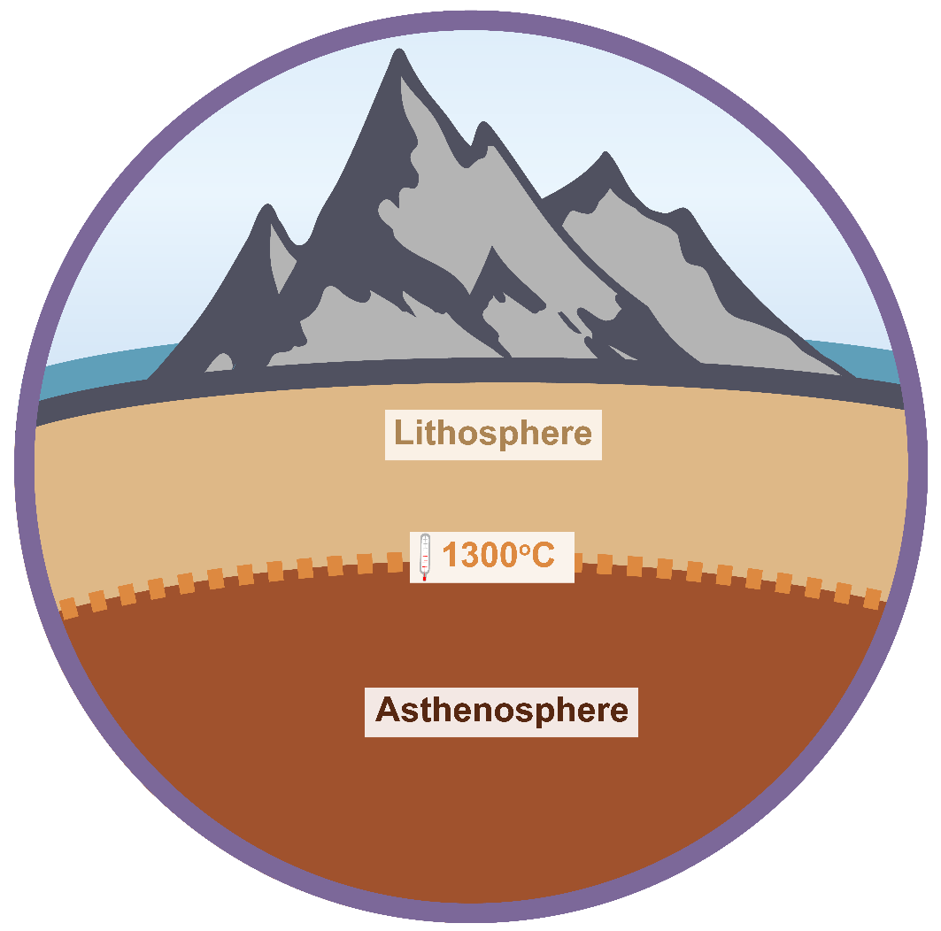
Lying underneath the lithosphere, there is the asthenosphere.
The asthenosphere consists of the “middle section” of the Earth’s mantle.
Geologists separate the asthenosphere from the lithosphere by temperature. The boundary between the lithosphere and asthenosphere is defined by a temperature of 1300°C.
Rocks that are cooler than 1300°C are part of the lithosphere, while rocks that are hotter than this set temperature are considered part of the asthenosphere.

Slide 7
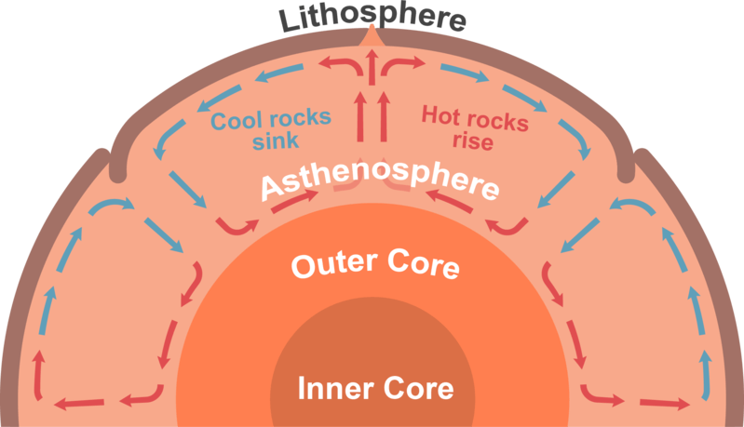
The asthenosphere is the denser, weaker layer beneath the lithosphere.
The asthenosphere is much more ductile than the lithosphere or the lower mantle beneath it.
The temperature and pressure of the asthenosphere are so high that rocks in this mechanical layer soften.
The rocks in the asthenosphere are soft enough that they are able to move, but very very slowly.
The asthenosphere can move because of a process called convection. You can learn more about this in the Plate Tectonics lesson.

Slide 8
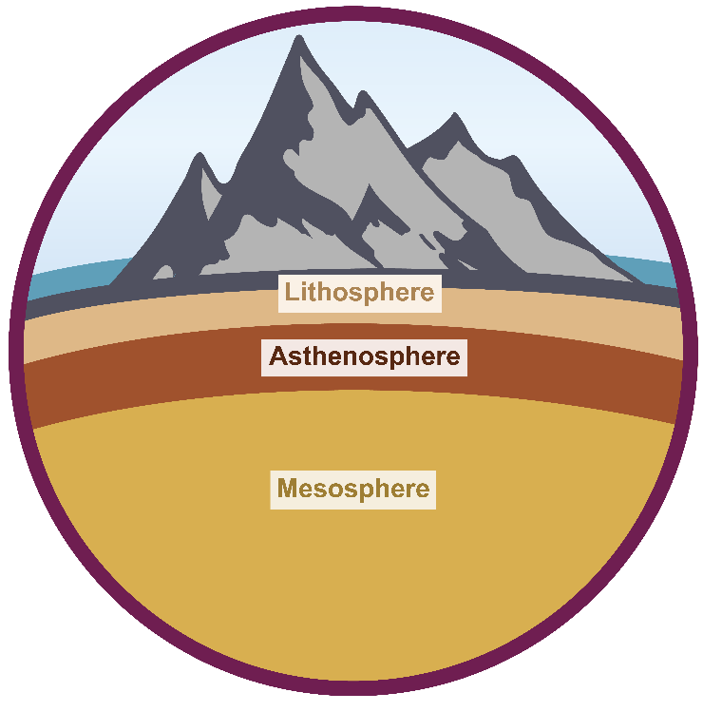
The final mechanical layer of the Earth we need to learn about is the mesosphere!
The mesosphere lies beneath the asthenosphere and above the outer core!
It encompasses the lower mantle, where rocks still flow and move, but at a much slower rate than the asthenosphere.
The temperature and pressure in the mesosphere is far greater than both the lithosphere and asthenosphere!

